Slide 1
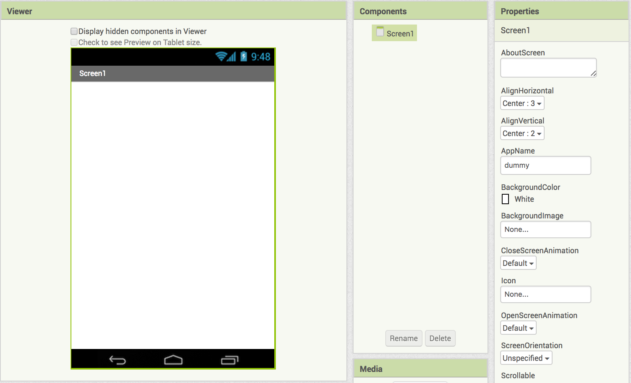
App Inventor Intro: HelloPurrWoof
Start a new project in App Inventor and name it HelloPurrWoof.
Click on Screen one and set
AlignHorizontal to Center: 3
AlignVertical to Center: 2

Slide 2
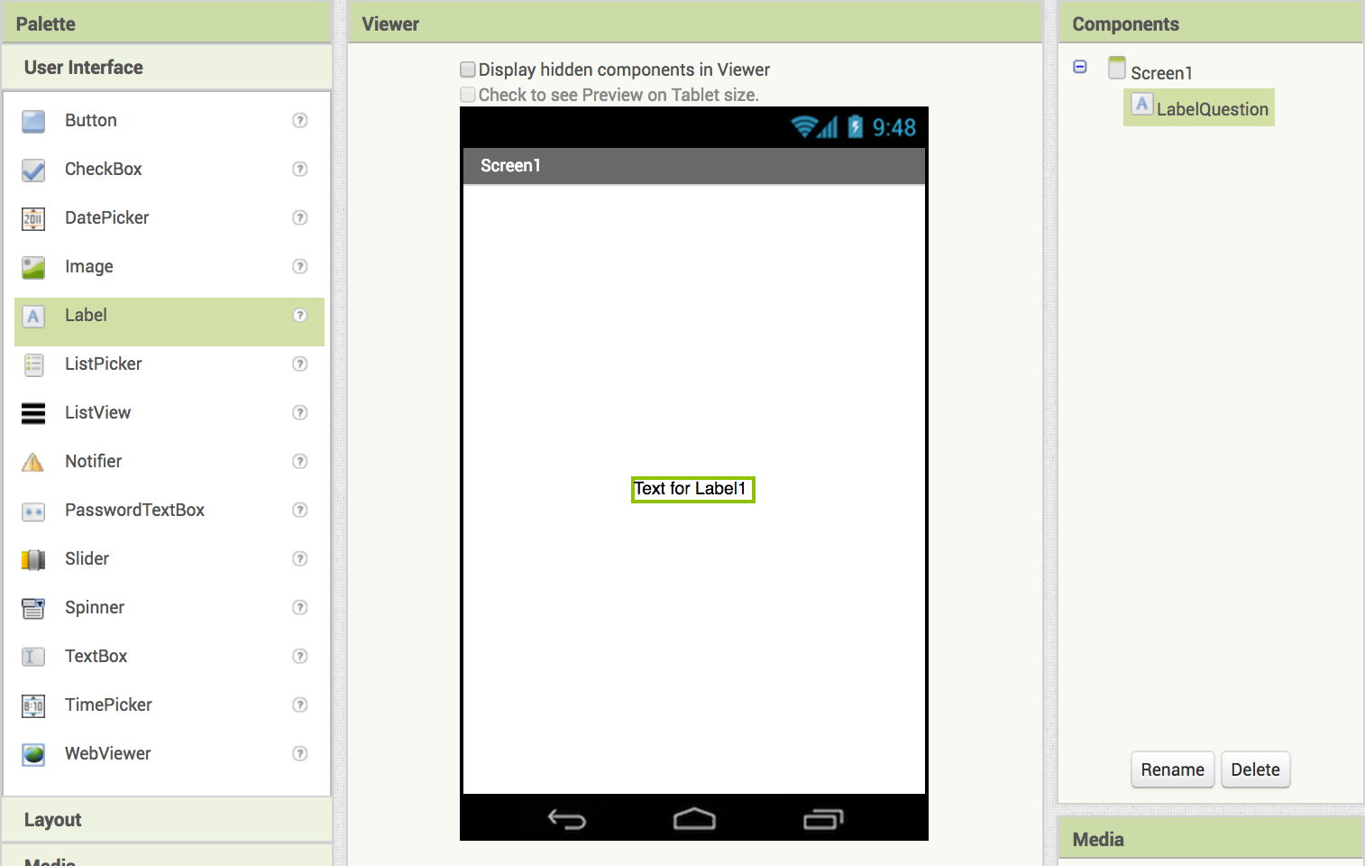
App Inventor Intro: HelloPurrWoof
Start a new project in App Inventor and name it HelloPurrWoof.
Add a label and rename it LabelQuestion

Slide 3
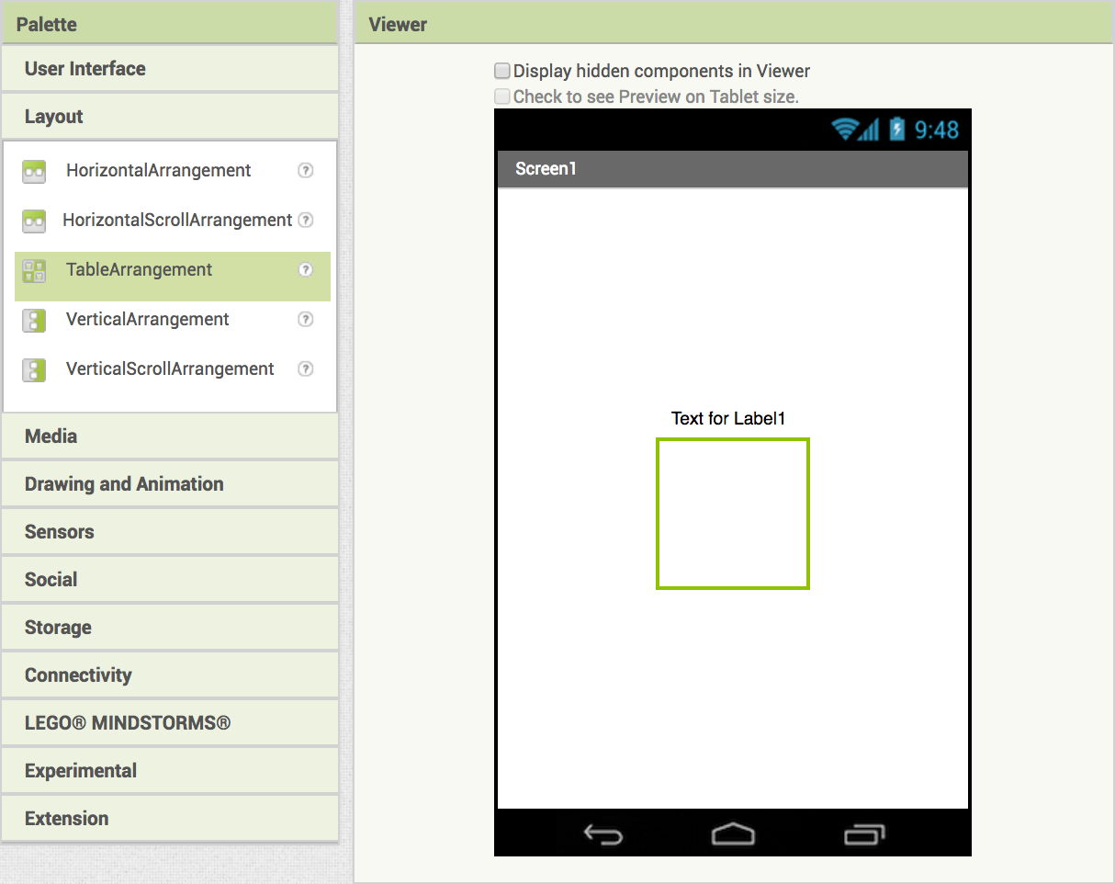
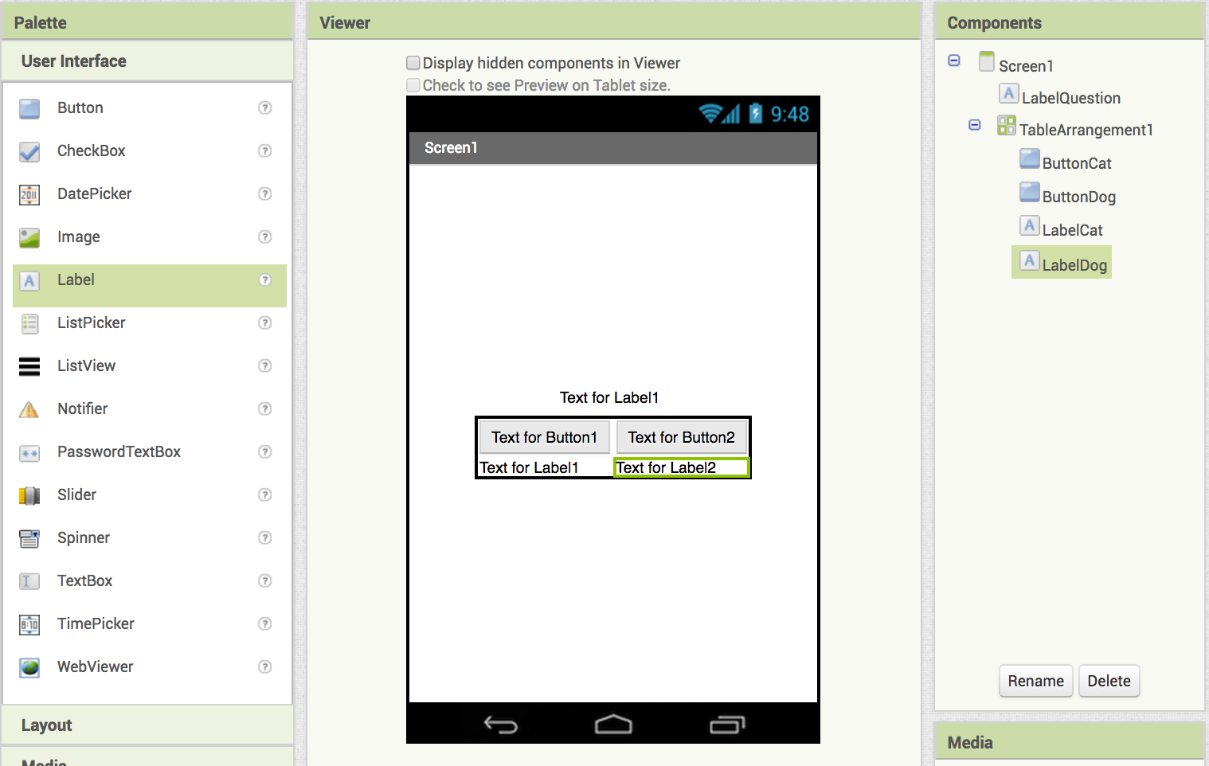
Drag in a TableArrangement
Inside the TableArrangement:
Add a button and rename it ButtonCat
Add a button and rename it ButtonDog
Add a label and rename it LabelCat
Add a label and rename it LabelDog

Slide 4
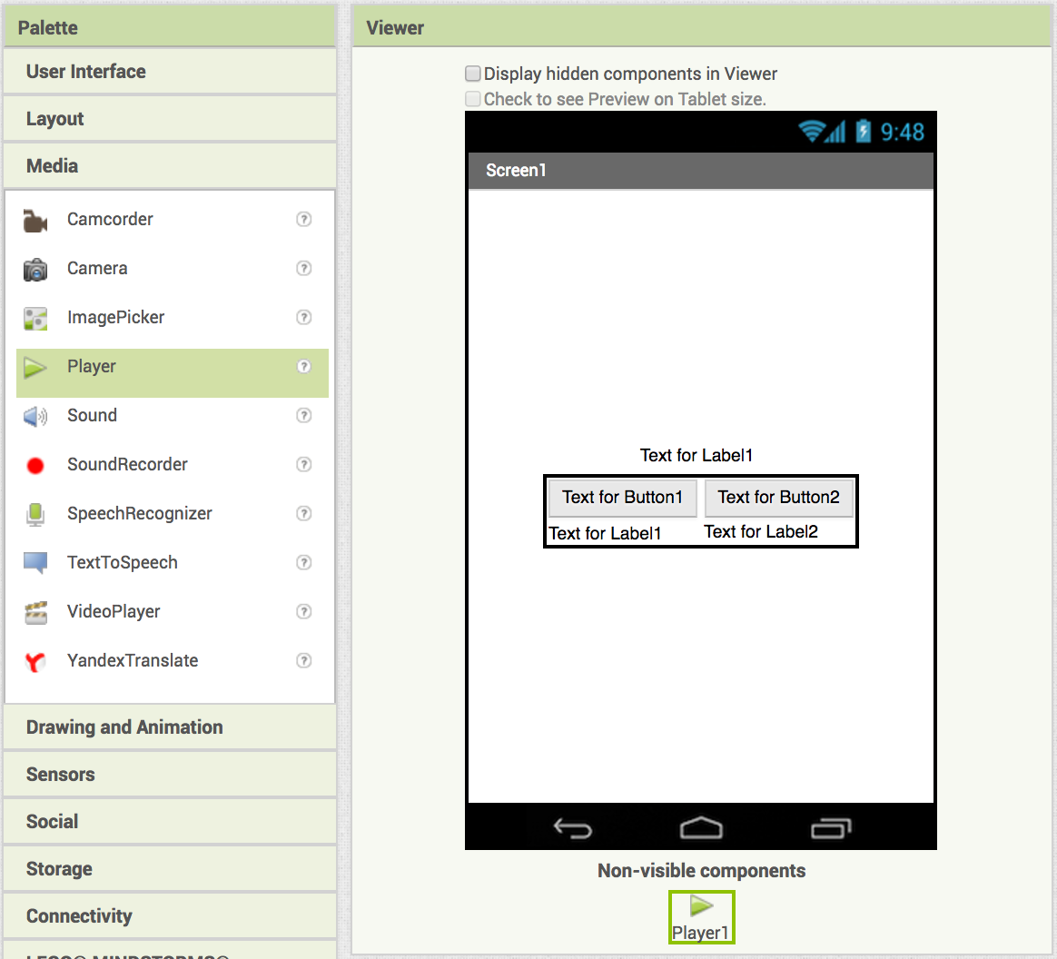
Now we need to set up our app to play sounds.
Drag in a Player component from the Media drawer
After you drag in the player, it will appear here.

Slide 5
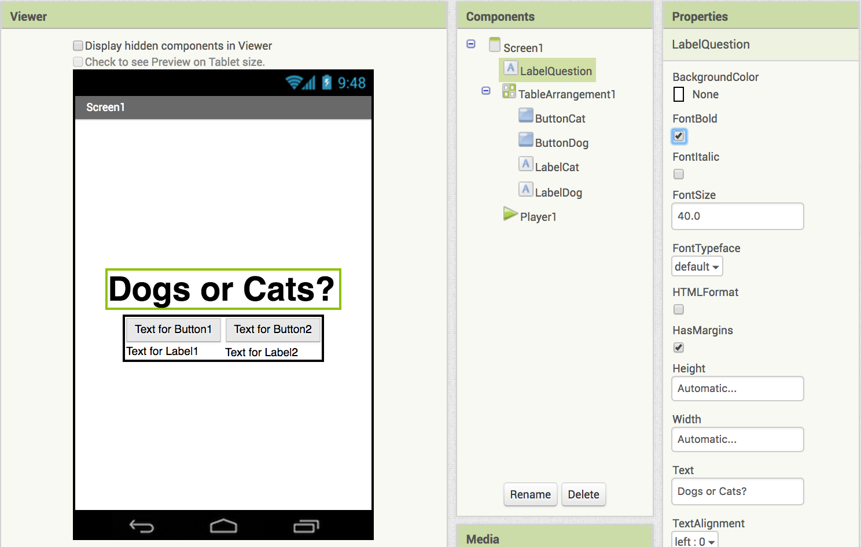
Let's update the LabelQuestion!
Select
Set to 40
Your LabelQuestion should now look like this.
Change text to:
Dogs or Cats?

Slide 6
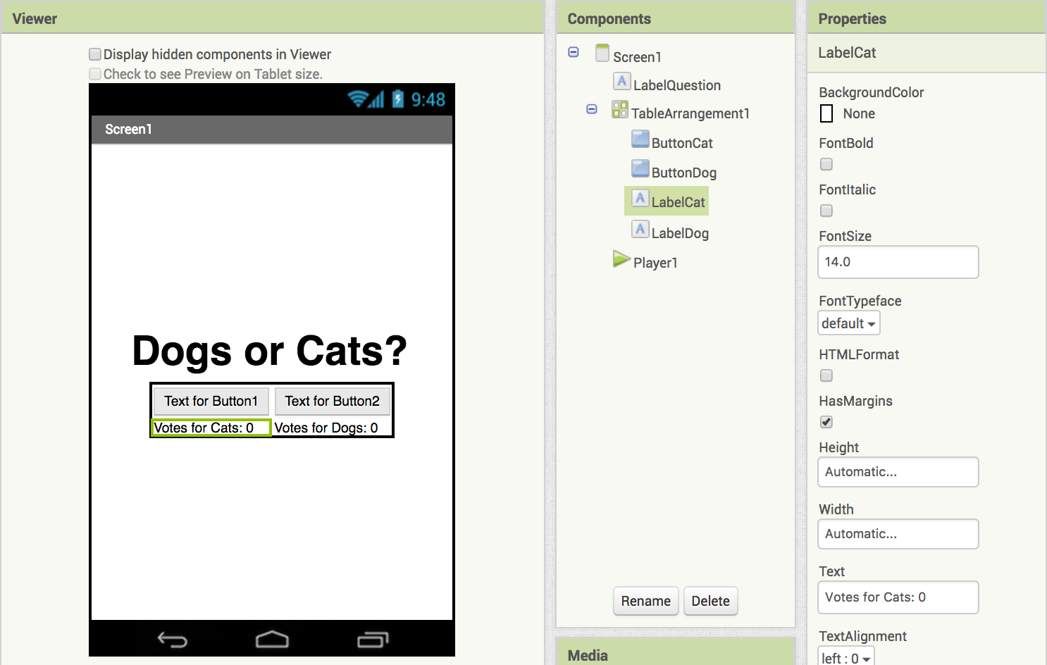
Now, update the LabelCat and LabelDog Text.
For LabelCat
Change text to:
Votes for Cats: 0
For LabelDog
Change text to:
Votes for Dogs: 0
Your LabelCat and LabelDog should now look like this.

Slide 7
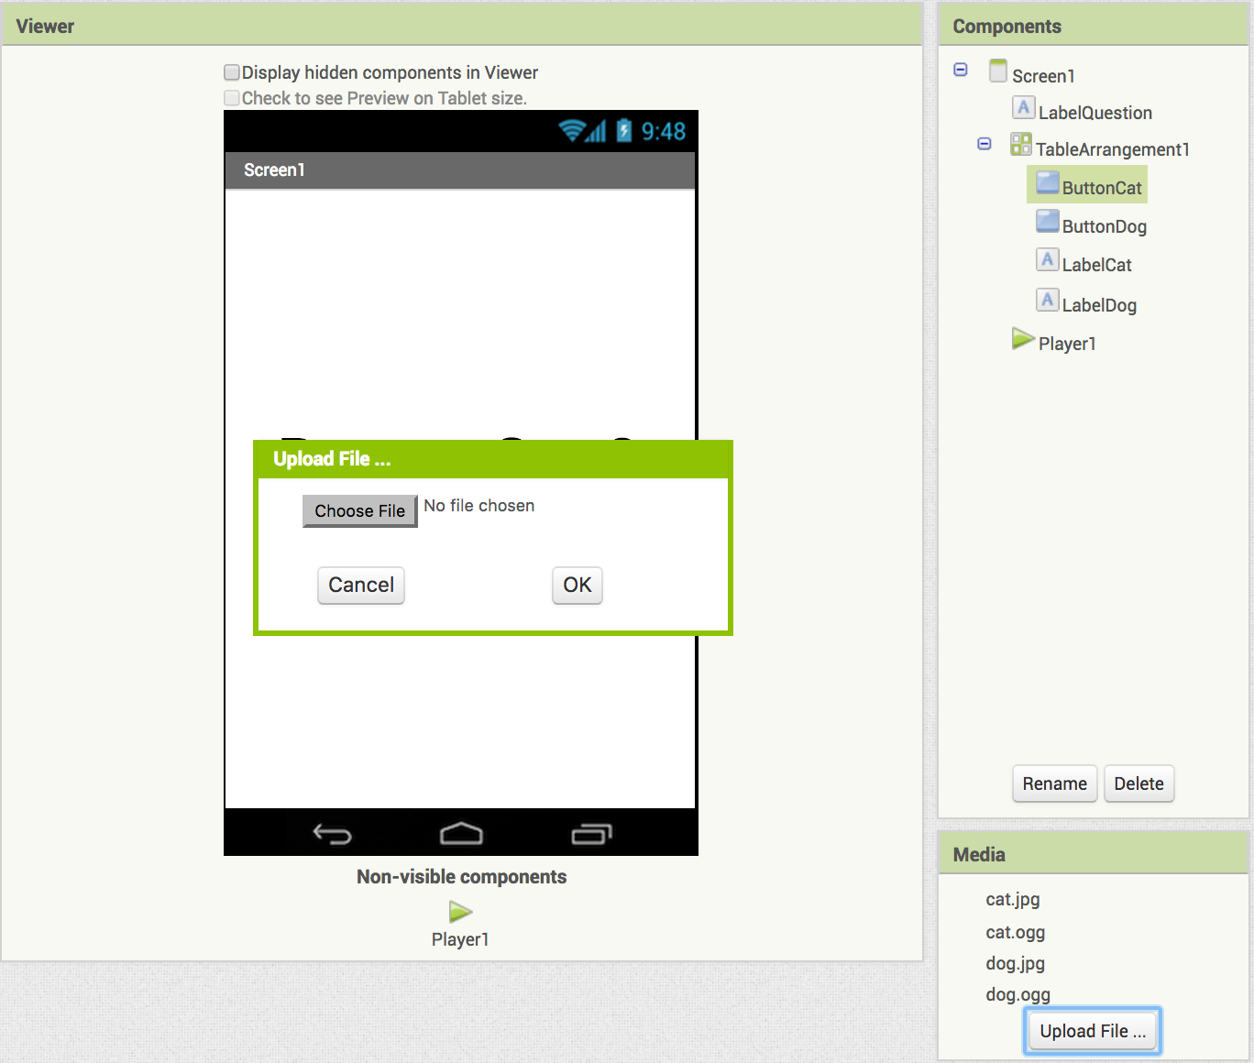
Upload the pictures and sounds for our app.
Download each of these files to your computer:
cat.png (our cat image) ( https://tinyurl.com/MITCIS-kitty )
cat.ogg (our cat sound) ( https://tinyurl.com/MITCIS-cat )
dog.jpg (our dog image) ( https://tinyurl.com/MITCIS-doggy )
dog.ogg (our dog sound) ( https://tinyurl.com/MITCIS-dog )
Your uploaded files should appear below
Under media, click on Upload File… then Choose File, find the images and sounds and upload them to your computer.

Slide 8
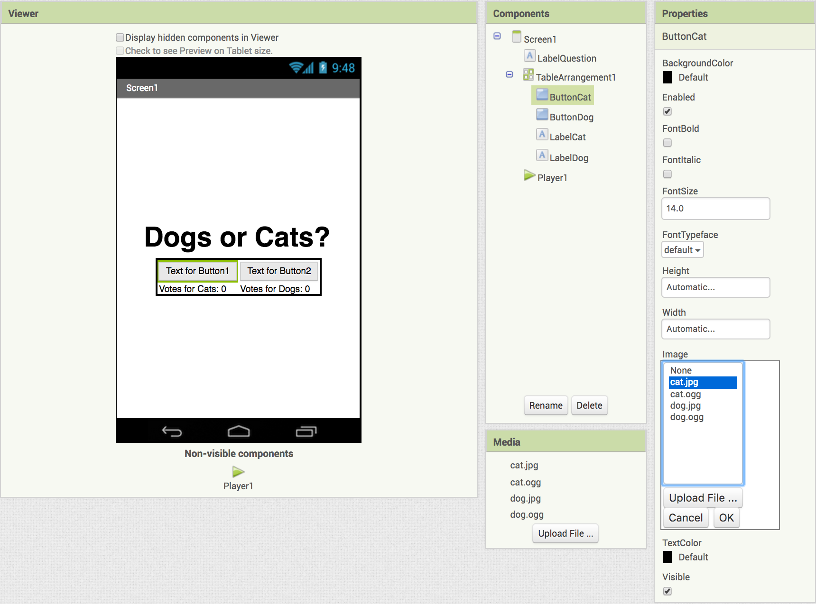
Set the pictures for ButtonCat and ButtonDog.
Under the Properties for ButtonCat click Image
choose cat.jpg

Slide 9
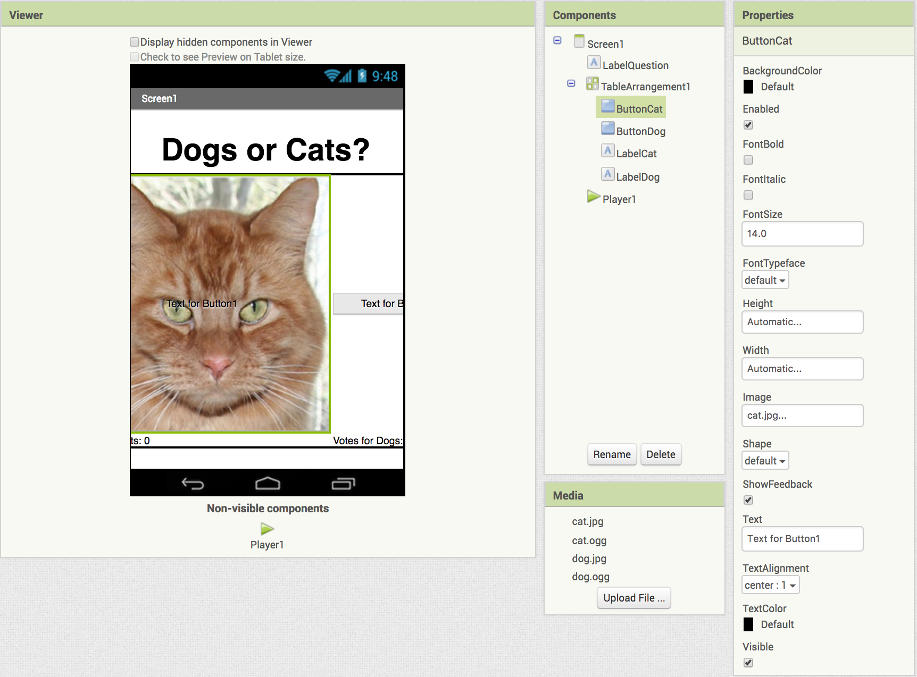
Your screen should look like this.
Let's fix the cat so it fits the screen!

Slide 10
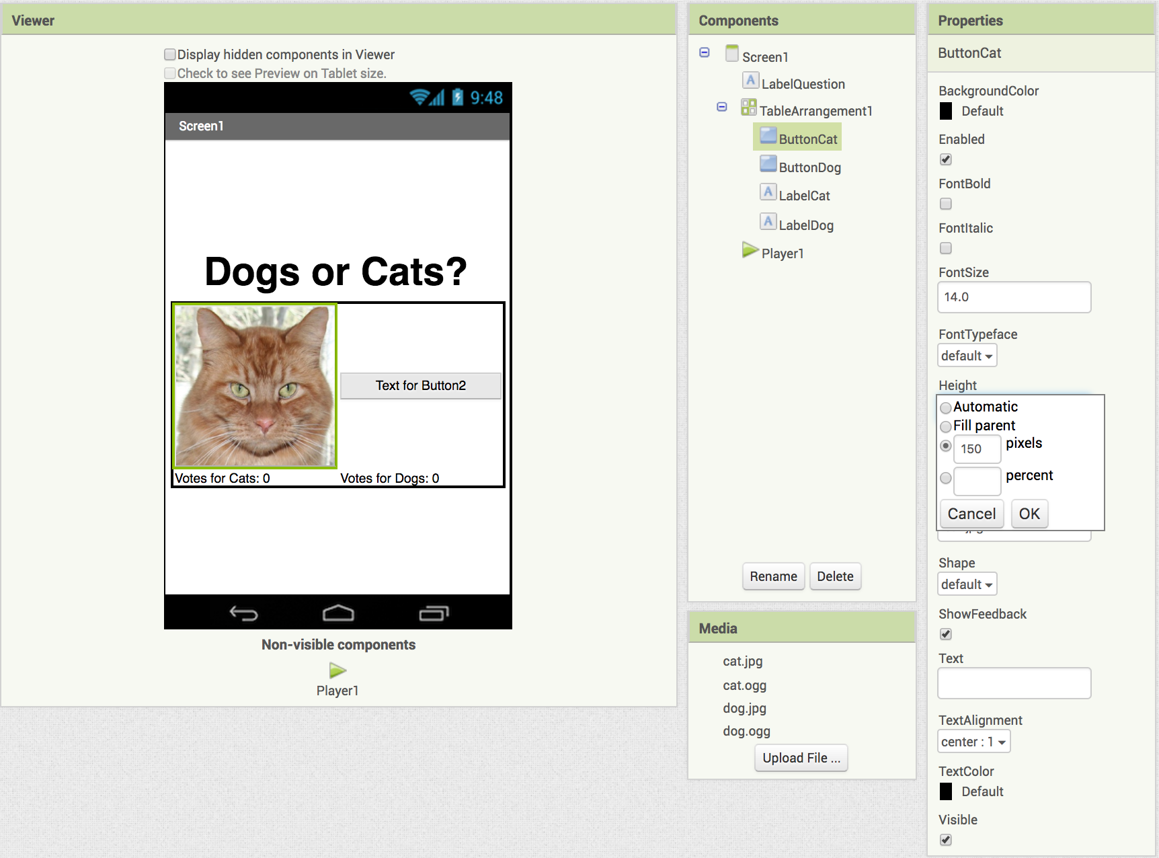
Set the image's height and width.
Under Properties, click on Height - set it to 150 pixels
Do the same for Width
Erase the words under Text
Your ButtonCat should now look like this.

Slide 11
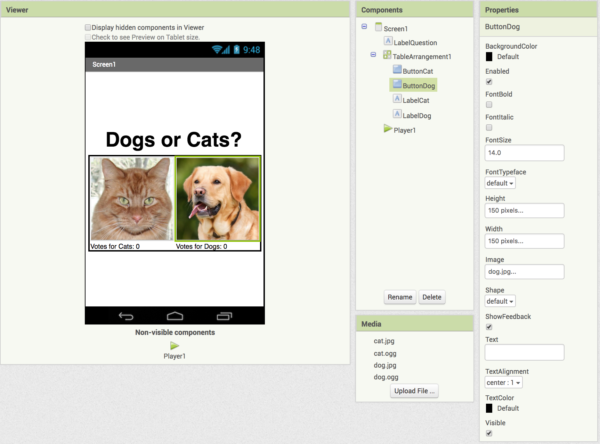
Repeat the steps for ButtonDog.
Select the dog.jpg Image
Set the Height and Width to 150 pixels
Erase the words under Text
Your screen should now look like this.

Slide 12
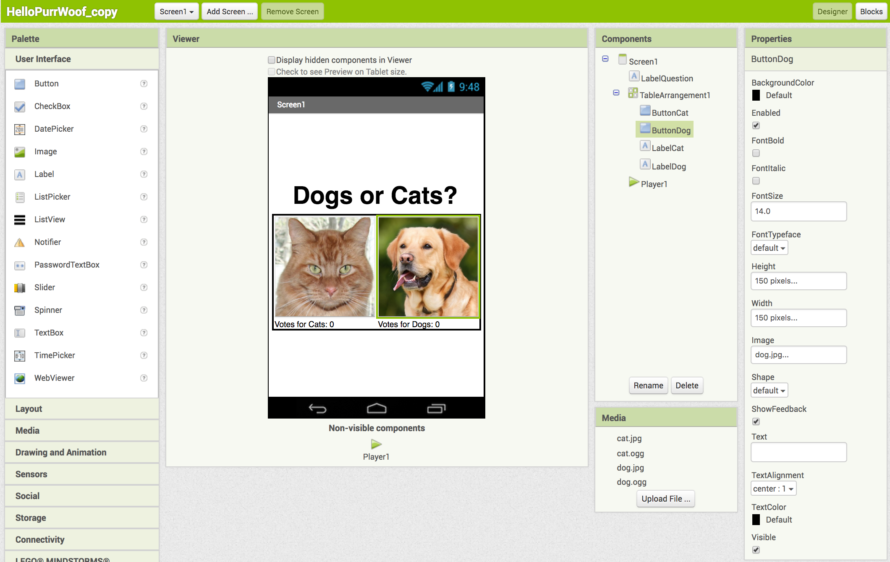
It’s time to code our app! Switch to the Blocks window (top right corner).

Slide 13

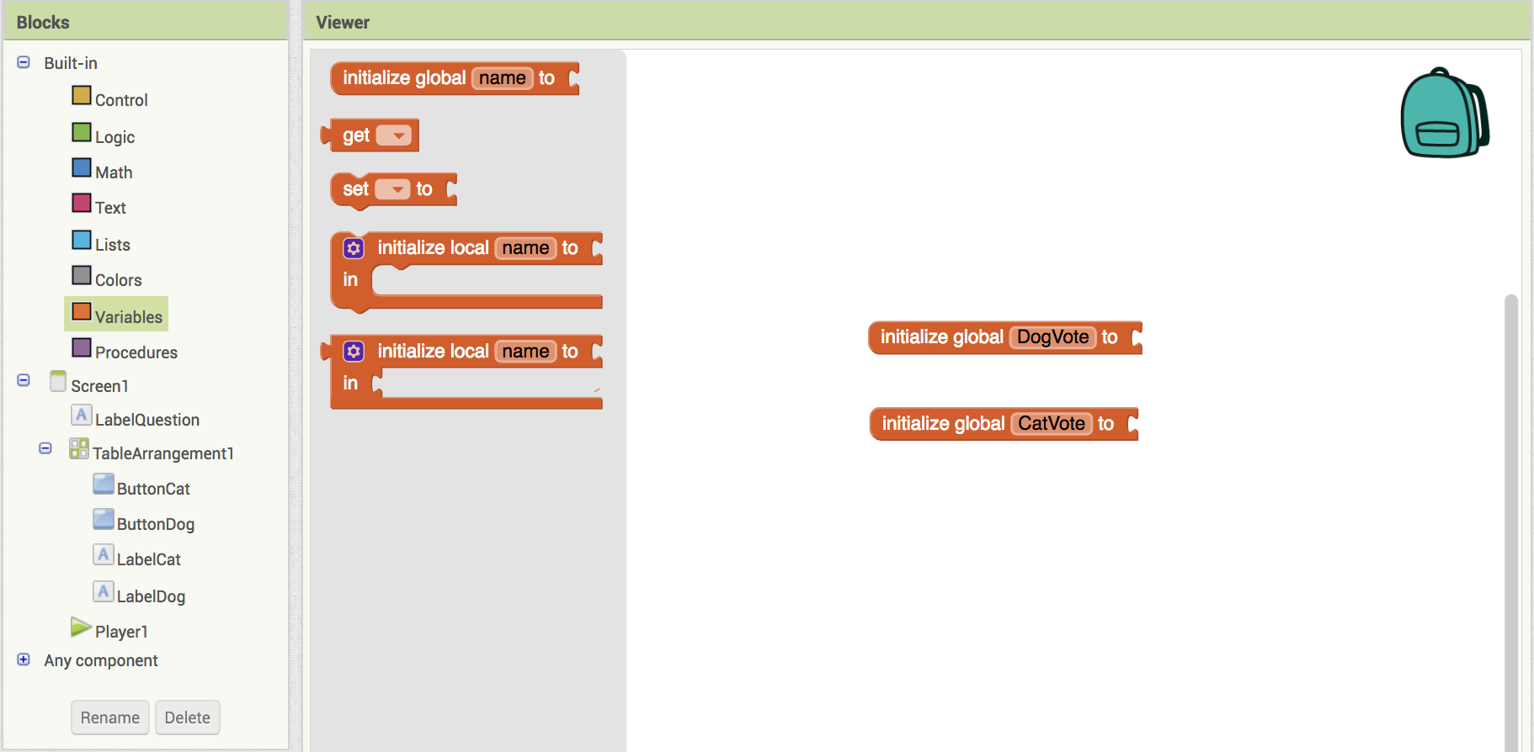
Create some variables to count the votes.
Click on Variables
Drag out two blocks
Rename the first DogVote
Rename the second CatVote

Slide 14
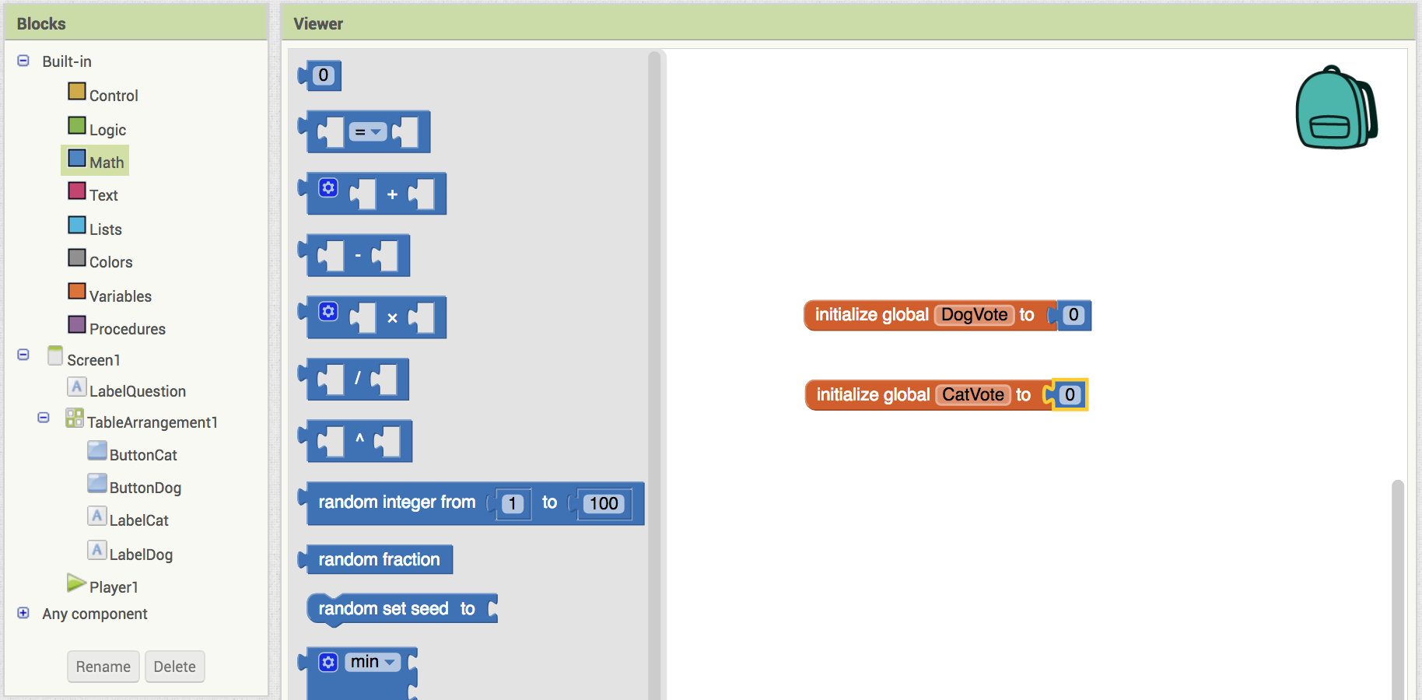
Set the vote counter variables to 0 to start.
Click on Math
Drag out two 0 blocks
Attach the first to DogVote
Attach the second to CatVote

Slide 15
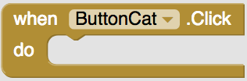
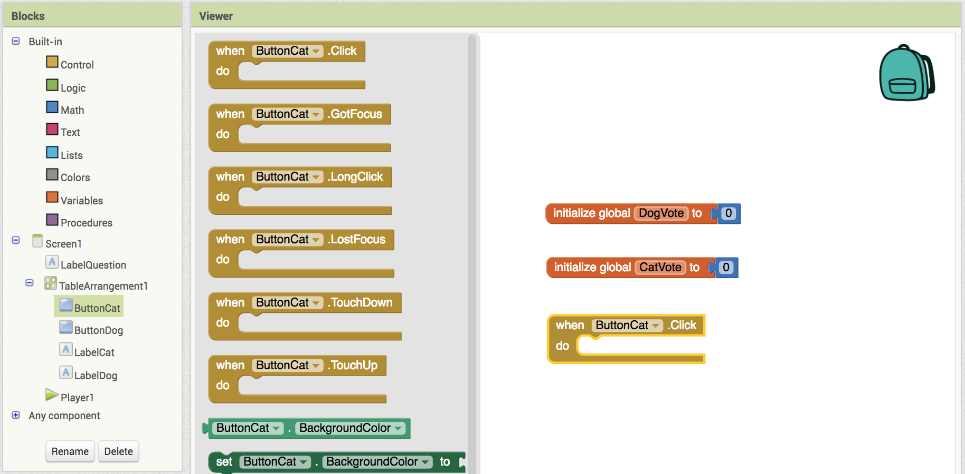
Programming the vote buttons.
Click on ButtonCat
Drag out
(this triggers an action when someone presses ButtonCat)

Slide 16
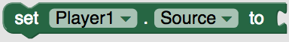
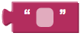
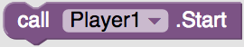
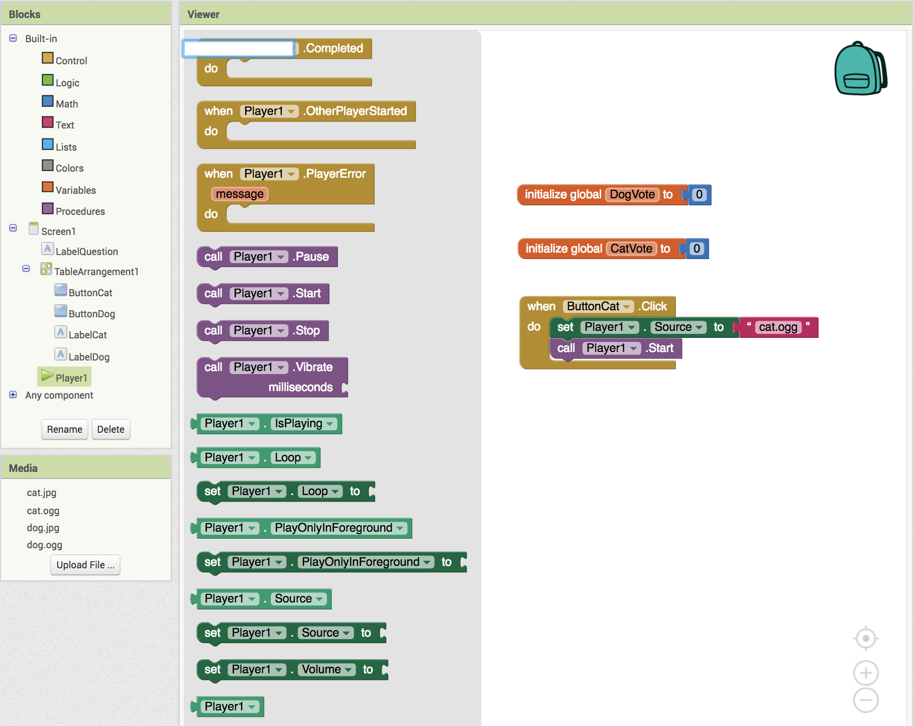
Making a sound play.
Click on Player1.
Drag out
From Text add and type cat.ogg (sets the sound to our cat meow)
Add (this makes the player play the sound)

Slide 17
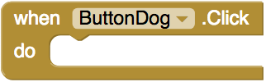
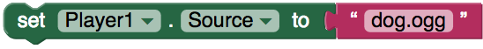
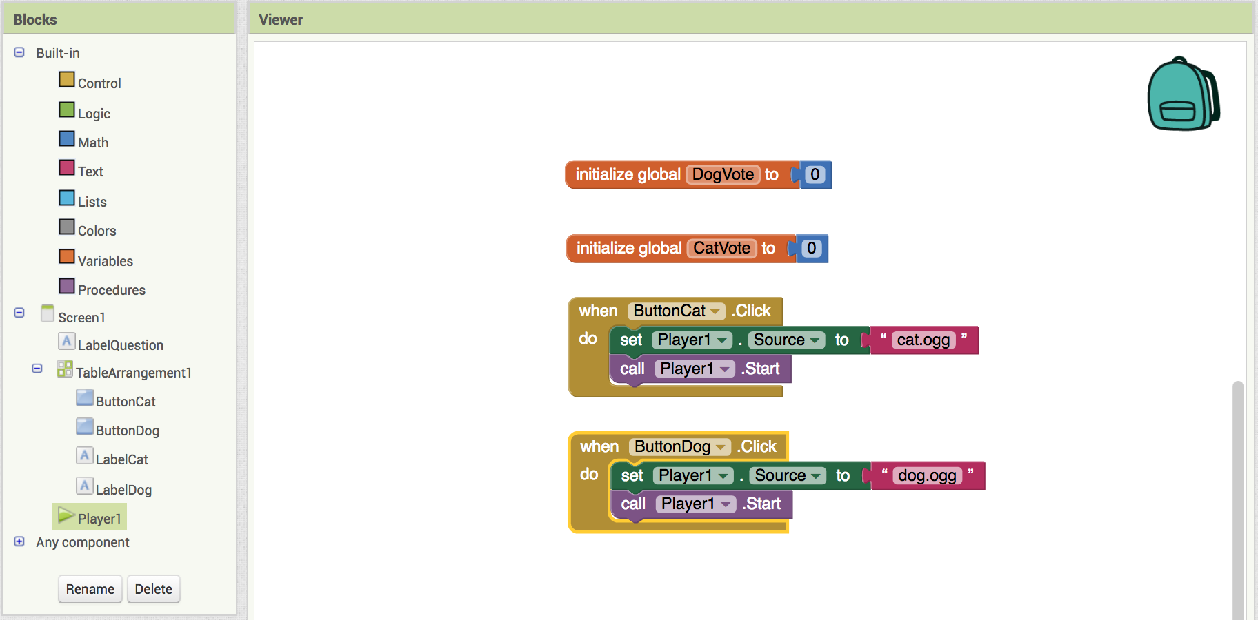
Repeat for DogButton.
Add
Add
Add
Your screen should now look like this.

Slide 18
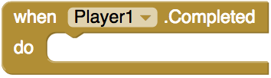
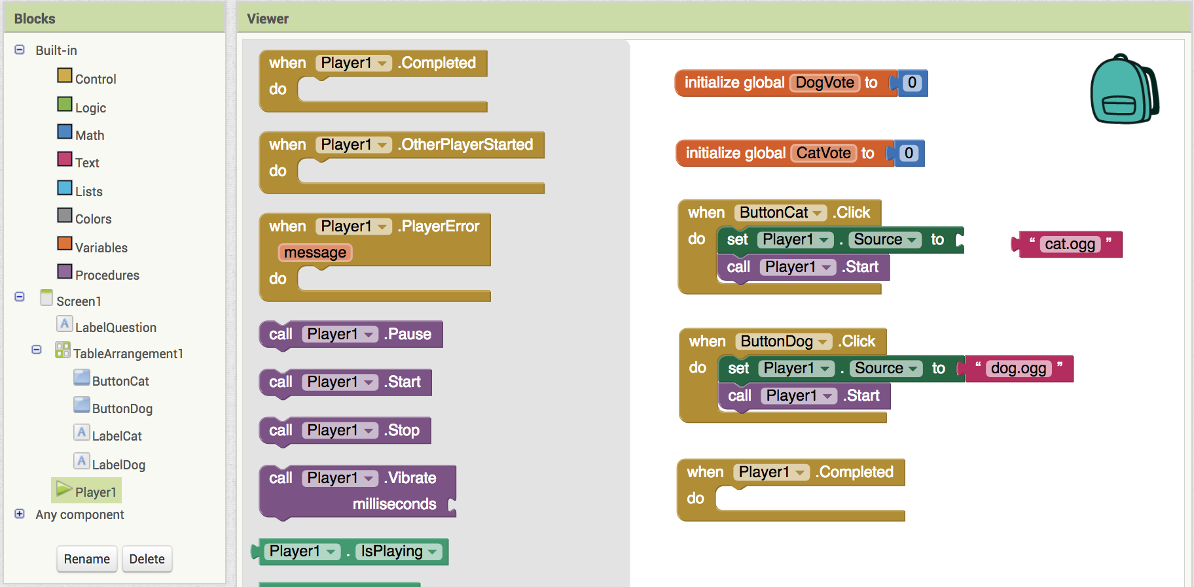
Adding the votes.
(this triggers an action when after the sound plays)
Add

Slide 19
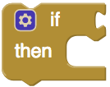
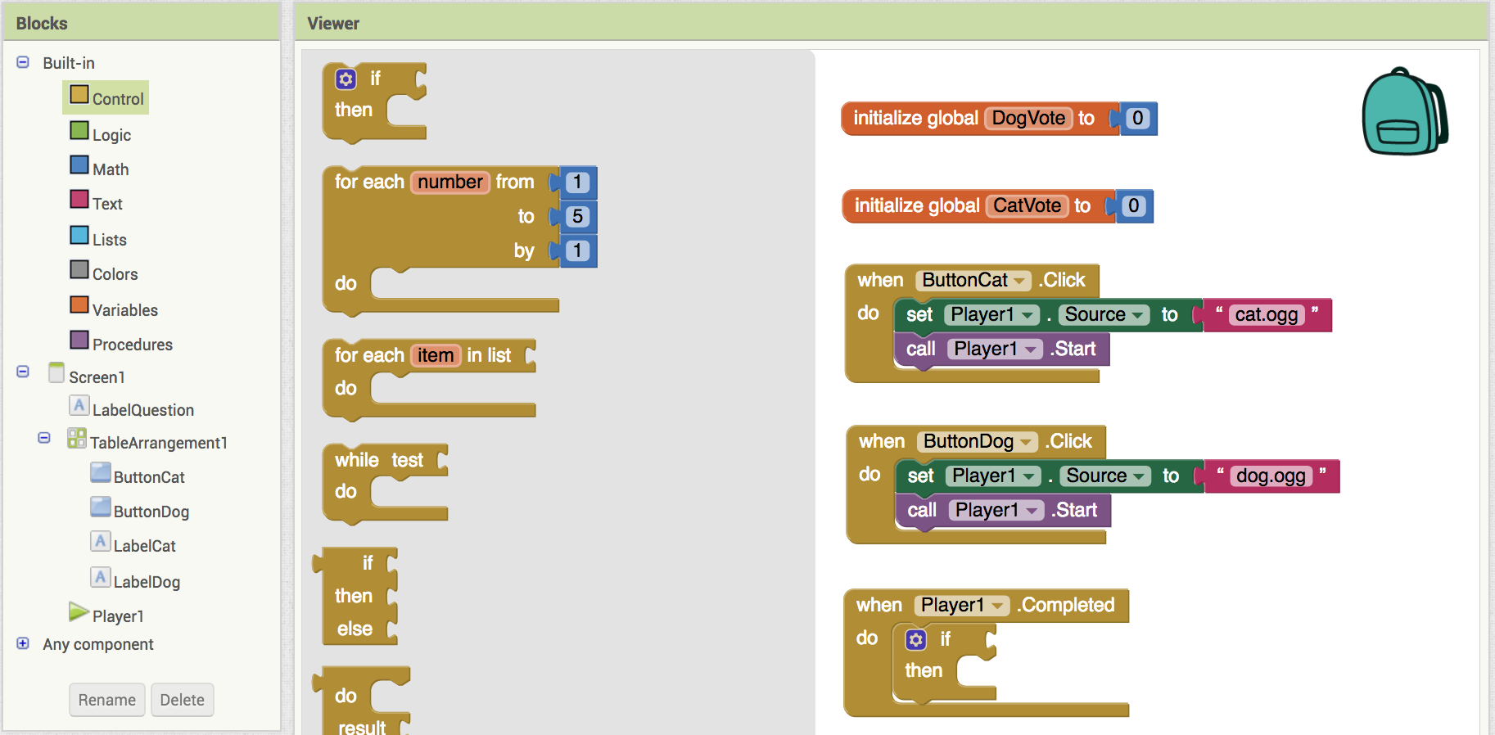
Adding an "IF" statement.
(this is a special block that says IF something happens THEN do something else)
From Control add

Slide 20
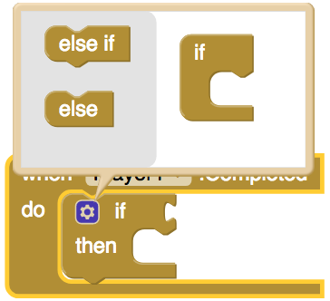


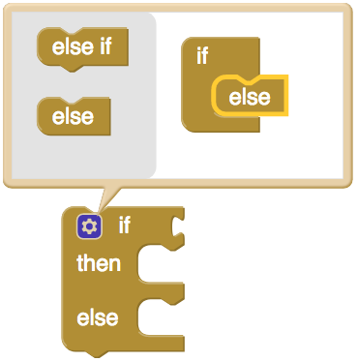
Adding an "Else IF" statement.
Click on the gear on the IF
You should see a pop-up
Drag the into the
You should see this appear if you did it correctly.

Slide 21

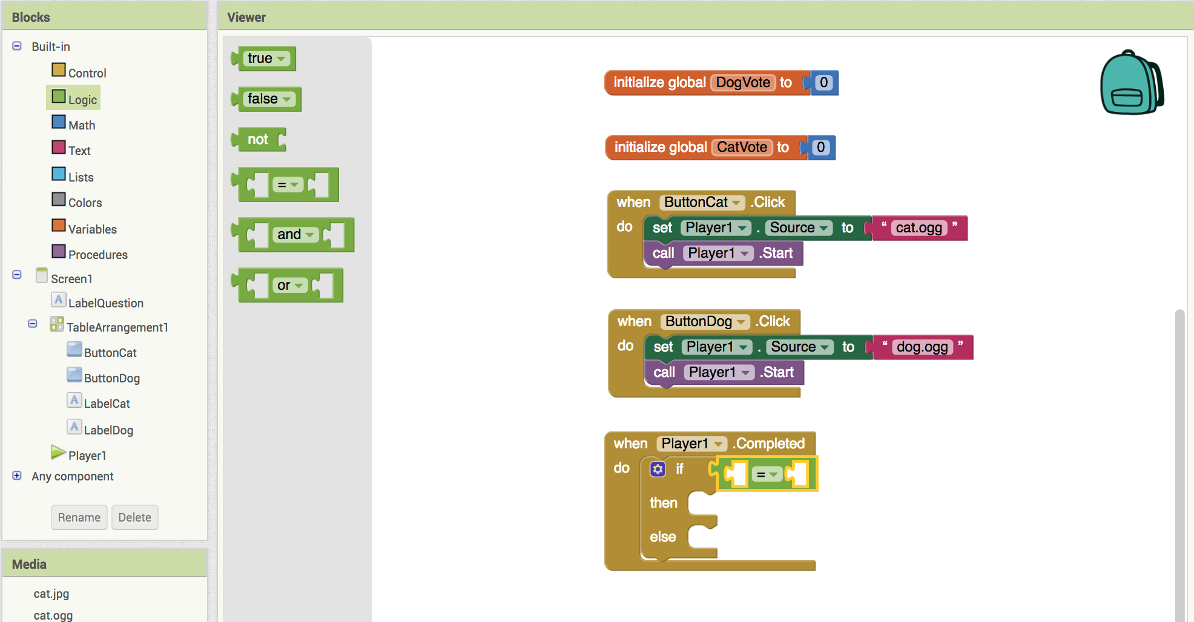
Checking the vote.
(this block looks to see if one block is the same (or equal) to another)
From Logic add

Slide 22

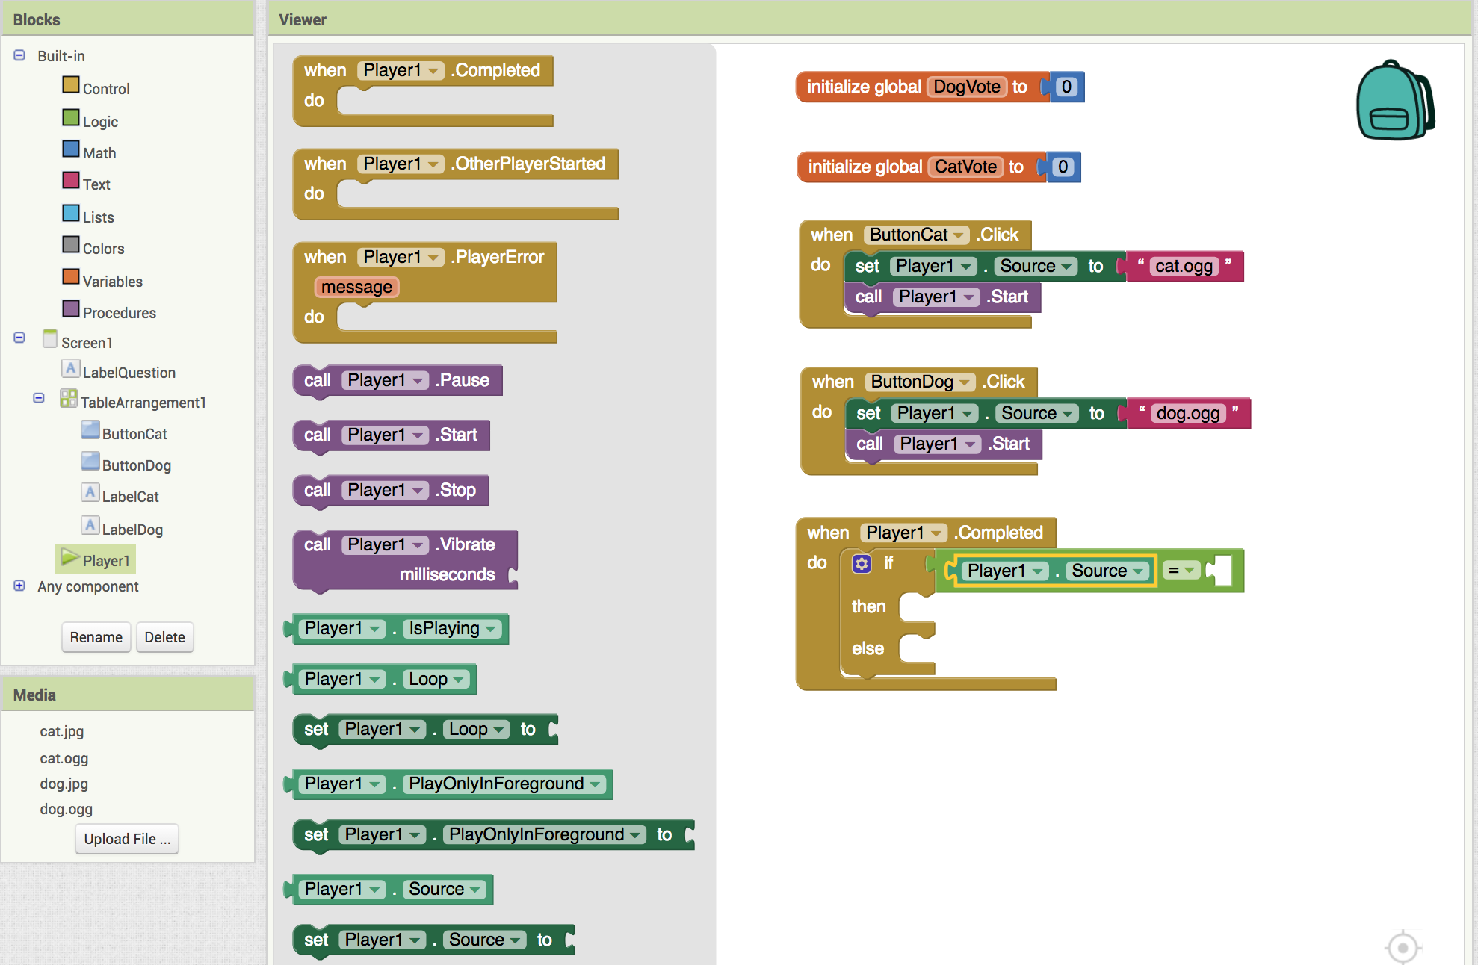
Checking the vote continued.
From Player1 add to

Slide 23
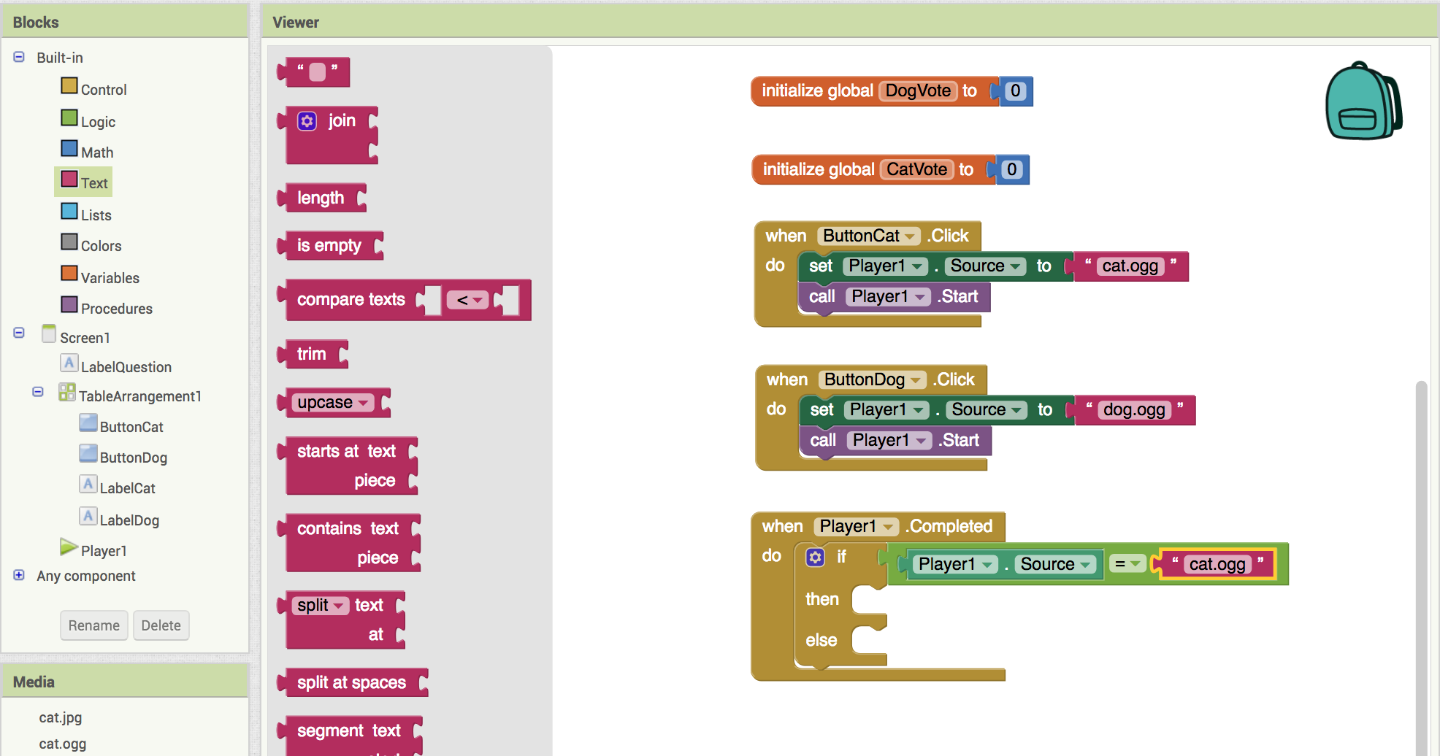
Checking the vote continued.
From Text add and type cat.ogg
(This will test to see if the Player1 had just played the cat meow)
Since we the only other option other than voting for the cat is voting for the dog, we don't need to write any extra code, the else handles this automatically!

Slide 24

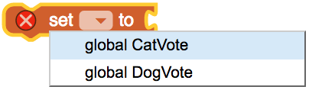



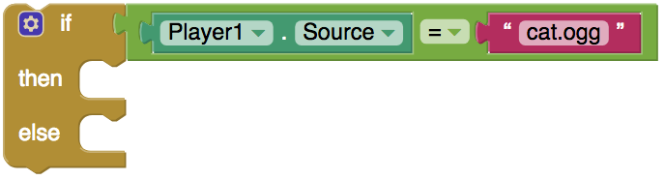
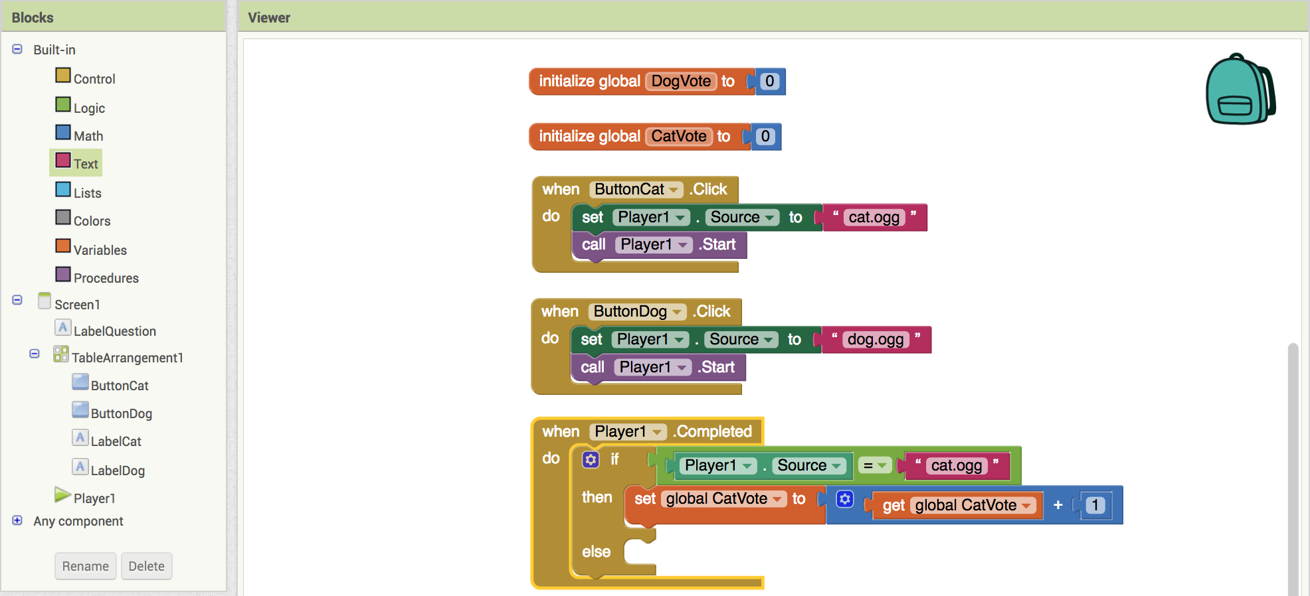
Adding a vote to the total.
From Variables drag in
Click on the arrow and choose CatVote
Connect a
From Variables connect a click the arrow and choose CatVote
From Math connect a and set it to 1
Connect all this to the Then part
of your If block
Your screen should now look like this.

Slide 25
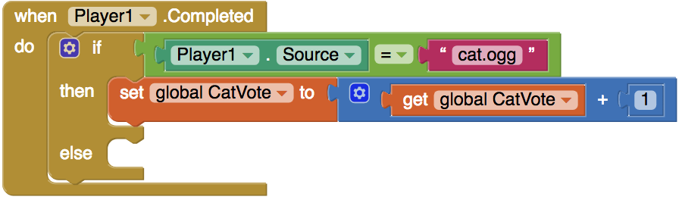
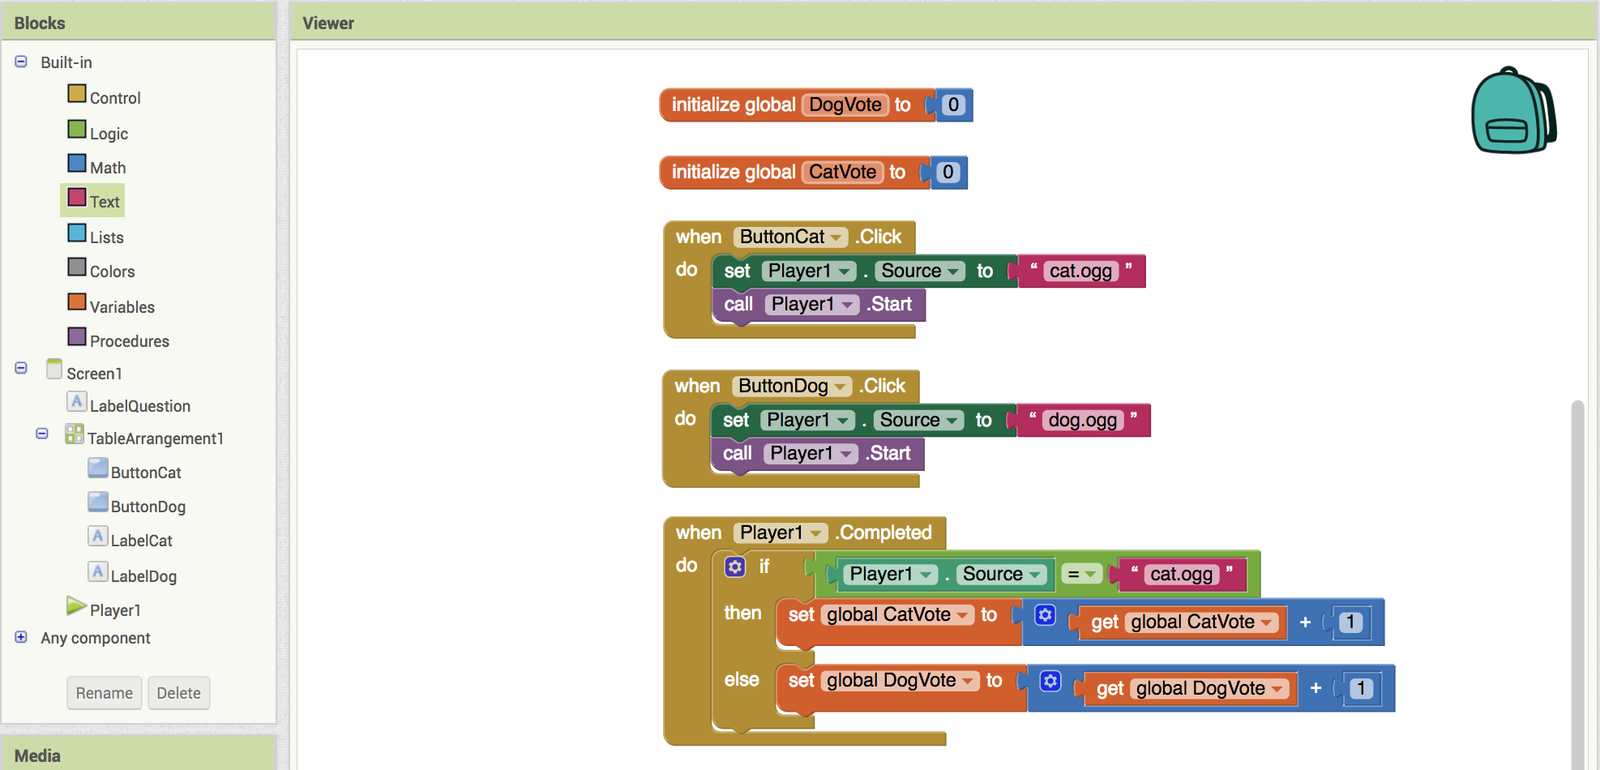
Repeat for Dog votes.
Do the same things you did for cats but for dogs and connect it to the else:
Your screen should now look like this.

Slide 26


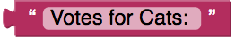

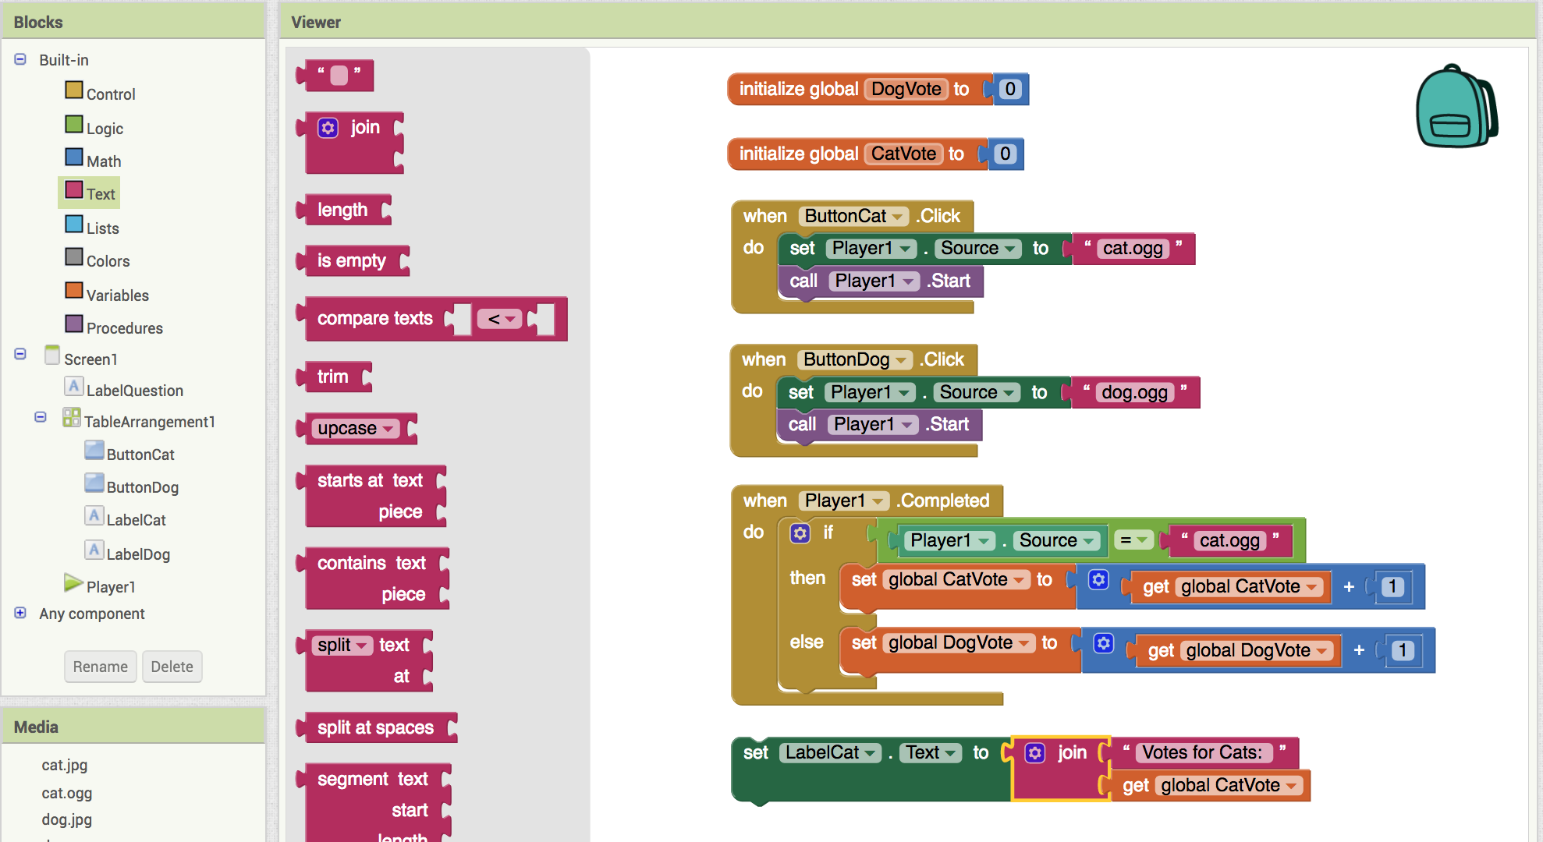
Updating the vote labels.
From LabelCat, drag in
From Text, connect a (this block joins two pieces of text together)
From Text, connect to the top of
From Variables, connect to the bottom of

Slide 27
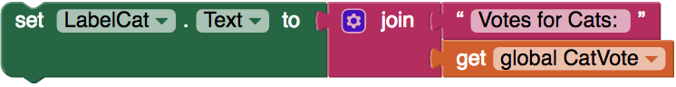
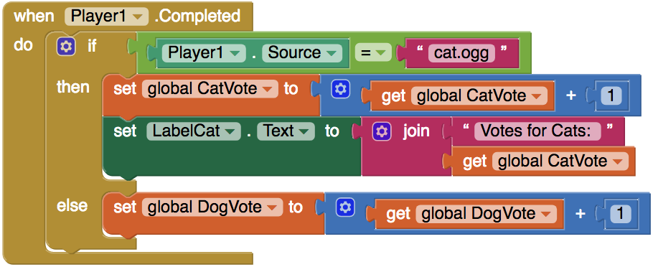
Updating the vote labels continued...
Connect
below
Your IF statement should now look like this:
Repeat for LabelDog.

Slide 28
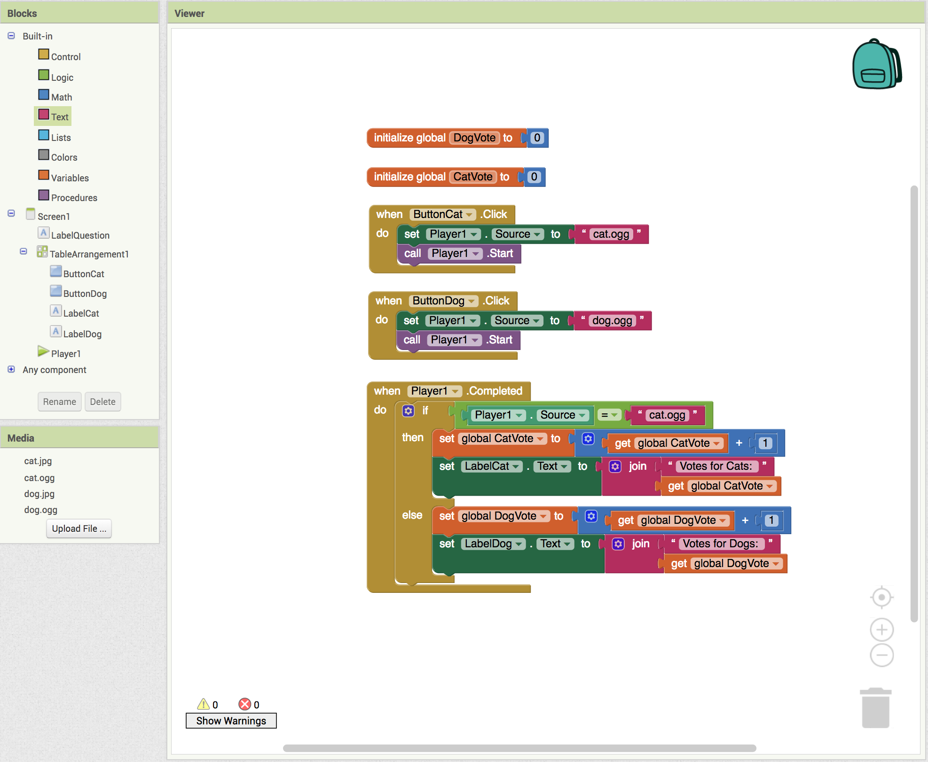
Your final code should look like this.
Now test it out and collect votes from your friends!

Slide 29
Further Exploration Questions
Why does the LabelDogVote and LabelCatVote update happen at the end? What happens if they are done before?
What are some other ways we could increment CatVote and DogVote?
Could we use two players instead of one player and changing the source? What else in the code would have to change if we used two players?
Is there anything to stop someone from voting 20 times?
What would we have to add so that we can click a button and “reset” the votes back to zero?
Change the app to be about something more interesting than voting if people like cats or dogs. What else could an app like this be used for?

